Slide 1
CUDA-Accelerated SMOTE: AN Overview

Slide 2
Code walkthrough (CPU path)
Pipeline (CPU)
Load → split: read CSV, split into minority (label=1) and majority (label=0).
KNN on minority: for each minority sample, compute distances to other samples, partial-sort to get k neighbors.
Pick “in-danger” points: weight by proximity to majority; sample points more at the boundary.
Interpolate: create synthetic rows along the line between a point and a chosen neighbor; append until classes balance.
Write: output output_balanced.csv.
Hotspots (areas with the highest time consumption)
Euclidean distance loops and partial sort (kNN) dominate runtime.
Interpolation is cheap; I/O is negligible compared to kNN.

Slide 3
Code walkthrough (GPU path)
What I moved to GPU (and why)
Distance matrix kernel: launch a 2-D grid where each thread computes a distance (i, j) across features; tile features into shared memory (reduces global reads).
Neighbor selection: use Thrust to partial-sort each row (or keep a per-row top-k heap).
(Option A) Interpolate on GPU with curand (one thread = one synthetic sample), then copy the finished synthetic block back to host.
(Option B) Keep interpolation on CPU (works fine; smaller win).
CPU still does
CSV I/O, class counts, assembling/writing the final dataframe.

Slide 4
Where GPU vs CPU in the code (simple map)
Step | CPU Version | CUDA Version
Read CSV / split classes | CPU | CPU
Distance compute (kNN) | CPU loops | GPU kernel
Partial sort top-k | Partial sort | Thrust sort_by_key / top-k
Interpolation | CPU | GPU or CPU (both options OK)
Write CSV | CPU | CPU

Slide 5
CPU VS. GPU: Testing Pipeline
Dataset generation:
  - Used benchmark_smote.py to create datasets (N=10,000 samples).
  - Varied features (10–1000) and minority proportion (1–40%).
  - Produced a full set of CSVs (see image).
Timing runs:
  - Benchmarked both CPU and GPU versions.
  - Logged results in timings.csv.
  - Paired CPU/GPU results into timings_paired.csv for speedup calculations.
Visualization:
  Used plot_speedups_combined.py to generate:
    Heatmap → overall parameter space.
    Speedup vs Features → dimensionality effects.
    Speedup vs Minority % → workload effects.
Purpose:
  - End-to-end process ensured fair comparison.
  - Allowed me to check if GPU acceleration actually made a difference and under what conditions.
Notes:
How I tested: To evaluate GPU acceleration, I designed a structured testing pipeline. I first generated datasets using benchmark_smote.py, fixing N = 10,000 samples while varying the number of features (10–1000) and minority class proportion (1–40%). This produced a comprehensive family of CSV datasets that covered the parameter space. For each dataset, I ran both the CPU and GPU versions of SMOTE and logged results in timings.csv. I then paired these results into timings_paired.csv, allowing direct speedup calculations (CPU time ÷ GPU time). Finally, I visualized the results using plot_speedups_combined.py, which produced three complementary plots: a heatmap of the full parameter space, speedup vs features, and speedup vs minority percentage. This pipeline ensured that I could objectively determine whether GPU acceleration provided a measurable benefit, and in which scenarios it mattered most.

Slide 6
Cpu Vs. Gpu Testing: Plot Overview
To evaluate whether the GPU provides a meaningful speedup for SMOTE-style data augmentation, I selected three complementary plots.
Speedup Heatmap:
- Purpose: Shows the entire parameter space (features × minority %).
- Why chosen: Helps quickly spot whether there are regions where the GPU clearly outperforms the CPU.
- Framing: I wanted a bird’s-eye view to check if GPU acceleration is consistent across settings, or if it only appears in specific cases.
Speedup vs Features (line plot)
- Purpose: Examines how performance changes as the number of features increases.
- Why chosen: Increasing feature dimensionality directly affects computational workload.
- Framing: I chose this to test if the GPU advantage grows with higher feature counts, or if the CPU remains competitive.
Speedup vs Minority % (line plot)
- Purpose: Examines how performance changes as the proportion of minority samples increases.
- Why chosen: More imbalance means more synthetic samples to generate, which may stress the CPU differently than the GPU.
- Framing: I chose this to see if the GPU only helps when augmentation is heavy, or whether it also speeds up smaller imbalances.
Notes:
Each plot was chosen to highlight a different way of testing whether the GPU provides a real speedup. The heatmap summarizes the full grid of results, while the line plots break it down into interpretable slices: one by features and one by minority percentage. Together, they let me investigate not just whether GPUs are faster, but under what conditions that difference actually matters.

Slide 7
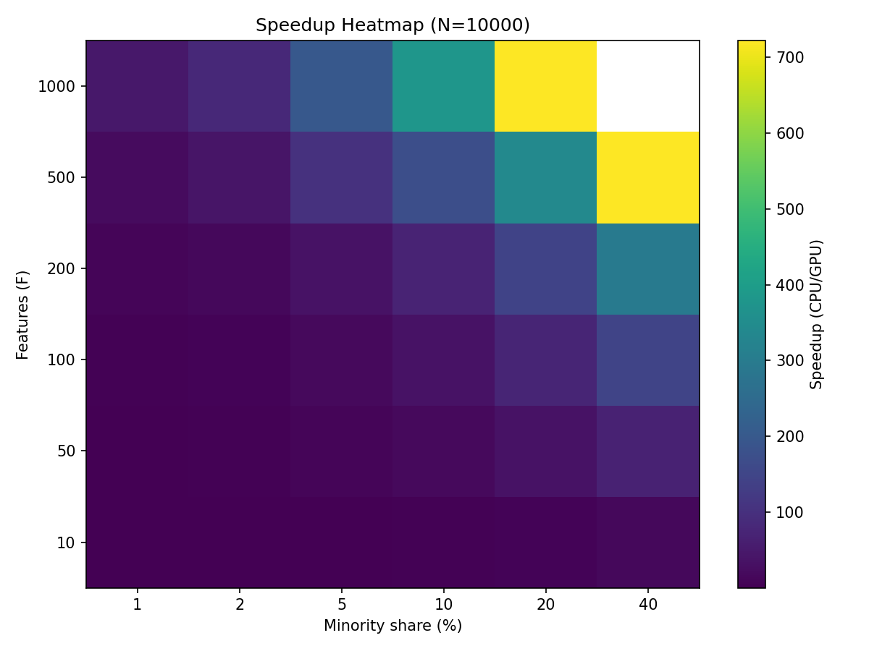
Speedup Heatmap (N = 10,000)
What it shows:
The heatmap places number of features (F) on the vertical axis and minority class proportion on the horizontal axis, with color intensity representing GPU speedup (CPU time ÷ GPU time).
Story:
For small problems (low F = 10–100 and low minority %), speedups remain modest or near parity, since GPU launch overhead cancels out the advantage and CPU remains competitive. As feature dimensionality grows (F ≥ 500) and minority share increases, GPU acceleration scales dramatically, with speedups in the hundreds as more synthetic samples drive larger workloads. The top-right white/yellow regions highlight extreme GPU dominance, up to ~700× faster than CPU.
Takeaway:
GPUs provide little benefit for small toy datasets but become essential for large, high-dimensional, and imbalanced augmentation tasks, where they deliver orders-of-magnitude improvements.

Slide 8
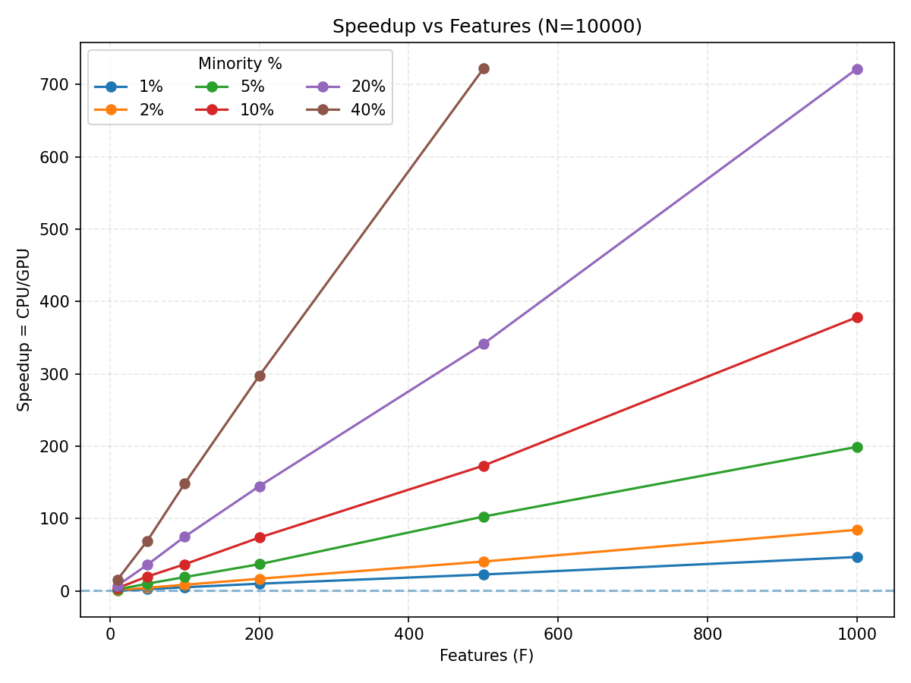
Speedup vs Features (N = 10,000) /w fixed minority %
What it shows:
Each curve fixes a minority percentage (e.g., 1%–40%) and varies the number of features. The y-axis tracks speedup, so we can see how GPU performance scales as dimensionality increases.
Story:
At very small feature sizes (F ≤ 50), GPU speedup is modest (about 1×–10×), meaning the CPU remains competitive. But as the feature count rises, GPU acceleration climbs steeply. At F = 1000, speedups range from 200× to 700× depending on the minority share. Higher minority percentages (10–40%) push the curves even higher, since generating more synthetic samples boosts the GPU’s parallelism advantage.
Takeaway:
GPU acceleration doesn’t just help at large scales — it transforms performance. Once datasets reach hundreds or thousands of features, GPUs show clear and scalable dominance, making them the practical choice for high-dimensional problems.

Slide 9
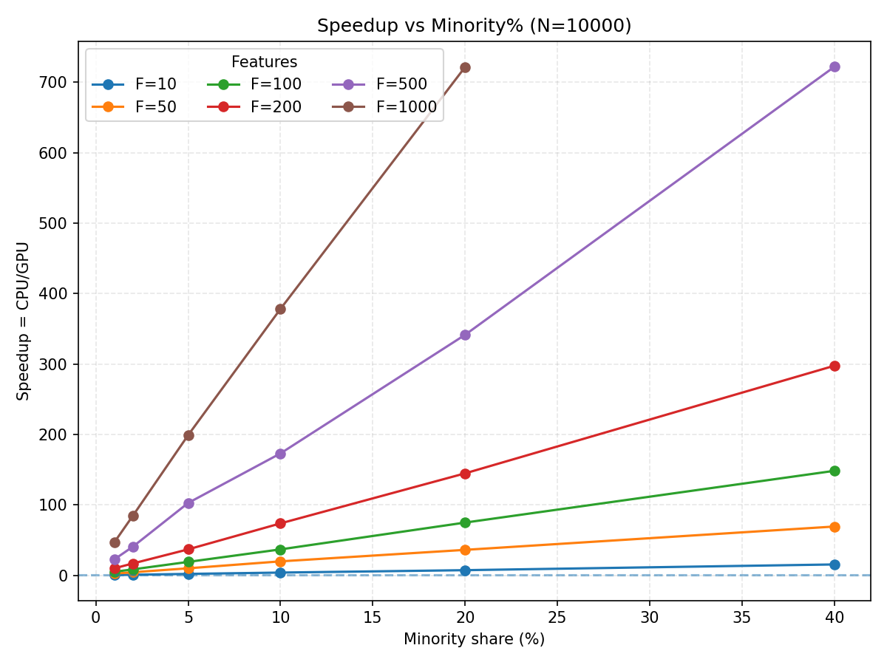
Speedup vs Features (N = 10,000) /w fixed minority %
What it shows:
Each curve fixes a feature count (F = 10, 50, … 1000) and varies the minority percentage. The y-axis shows speedup, letting us see how GPU advantage scales with increasing class imbalance.
Story:
At very low minority shares (1–2%), GPU speedups are modest across all feature counts — here the CPU can keep up, especially for small F. As the minority percentage rises, the curves steeply increase, with high-dimensional datasets (F = 500, 1000) reaching 300–700× faster runtimes. For small feature counts (F = 10, 50), the GPU remains limited regardless of minority size, as the problem is too small to fully exploit parallelism.
Takeaway:
GPU acceleration is most impactful when both dimensionality and minority percentage are large. For tiny minority fractions, the CPU may be acceptable in small problems, but as soon as feature space grows, GPUs consistently dominate.

Slide 10
What I could have changed
Larger datasets (N > 10,000): Could have tested scaling beyond 10k samples to see how GPU behaves with truly massive data.
Multiple GPU types: Results are from a single GPU. Different architectures (e.g., consumer vs data-center cards) might show different trends.
More repetitions per test: Averaging over more runs would smooth out noise and give tighter confidence in timings.
Alternative baselines: Only compared to CPU implementation; could also compare against multi-threaded CPU libraries (e.g., joblib, scikit-learn with parallelism).
Memory profiling: Speed isn’t the only factor; GPU memory usage could have been tracked to highlight tradeoffs.
Visualization options: Could combine all plots into interactive dashboards for easier exploration.

